Slide 1
Covid-19 and Indian Economy
Presented by Group members
Sumit Raj (1801CS53)
Ammaar Ahmad (1801CS08)
Ayush Pandey (1801CS11)
Souhardya Das Chowdhury (1801CS51)

Slide 2
What is Covid-19 Pandemic ? Has it impacted our Economy?
At first let us see , what is Covid-19?
The COVID-19 pandemic in India is part of the worldwide pandemic of coronavirus disease 2019 (COVID-19) caused by severe acute respiratory syndrome coronavirus 2 (SARS-CoV-2). The first case of COVID-19 in India, which originated from China, was reported on 30 January 2020. India currently has the largest number of confirmed cases in Asia, and has the third highest number of confirmed cases in the world after United States and Brazil with the number of total confirmed cases.
In this presentation , we will be discussing about the impact of Indian Economy hit due to this pandemic and also would look at the suggestions/decisions to get past the gloomy phases.

Slide 3
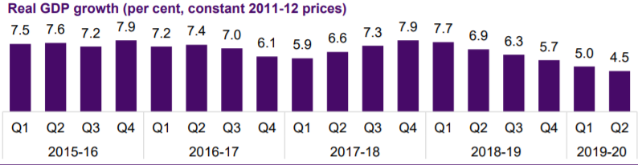
Impact of COVID-19 on Indian economy
The sudden decline in economic activities due to the lockdown is unexpected in the history of India.
Here are some figures that describes the current situation of India.
Condition of Indian Economy before lockdown:
Expected GDP growth rate in 2020-2021 : -3.2%
GDP growth in 2020-21 likely to go negative, says RBI Governor
(source: THE HINDU , updated: MAY 22, 2020 12:09 IST)

Slide 4
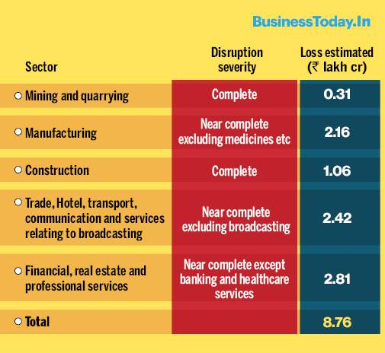
Union minister Nitin Gadkari said that the country is expected to lose revenue of about ₹10 lakh crore or 5 per cent of India's GDP due to the coronavirus crisis
As estimated at the end of march(lockdown 1.0)

Slide 5
How the pandemic will impact different sectors
These are some affected areas :
Automotive
Drugs and Pharmaceutical
Food Production
Retail/Wholesale Non-food items
Textiles
Entertainment
Banking
Tourism
Hospitality
Electronics
Next we are going to discuss briefly about these affected areas.

Slide 6
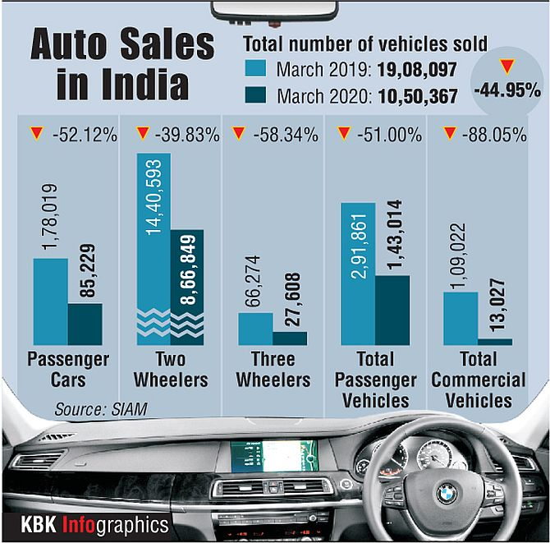
Automotive
Demand of vehicles likely to be deferred or dropped. Component dependency will create supply side disruption.

Slide 7
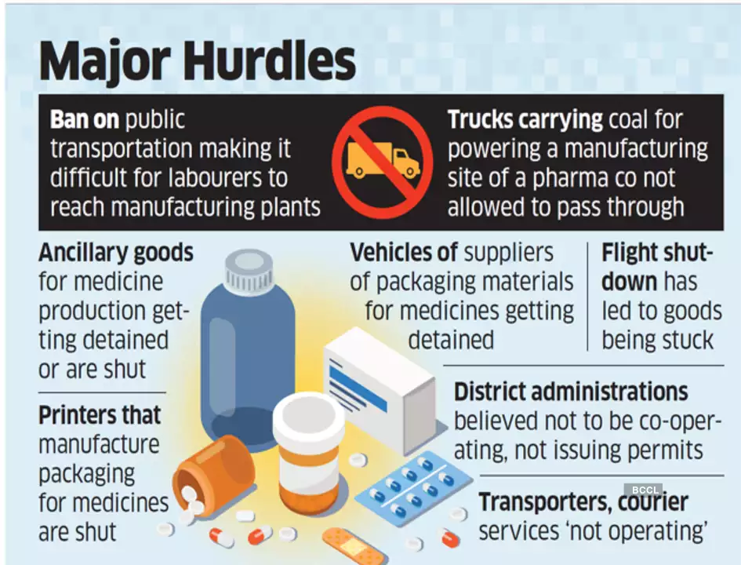
Drugs and Pharmaceutical
Production expected to recover quickly. Supply chain disruptions may persist.

Slide 8
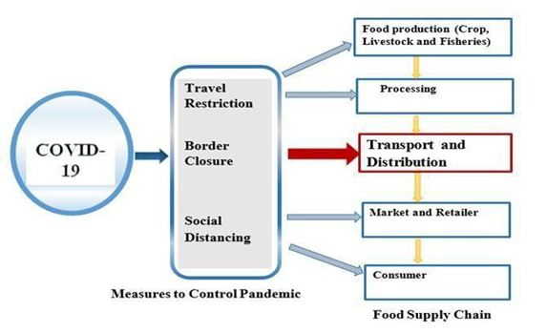
Food Production
Prices and demand may increase after the outbreak

Slide 9
Retail/Wholesale Non-food items
Pent up demand will aid a fast recovery
More than 95% of Non-food retailers have their shops closed in the lockdown and are looking at practically no revenues till the lockdown is in place. In the next 6 months, non-food retailers expect to earn 40% as compared to last year’s revenues.

Slide 10
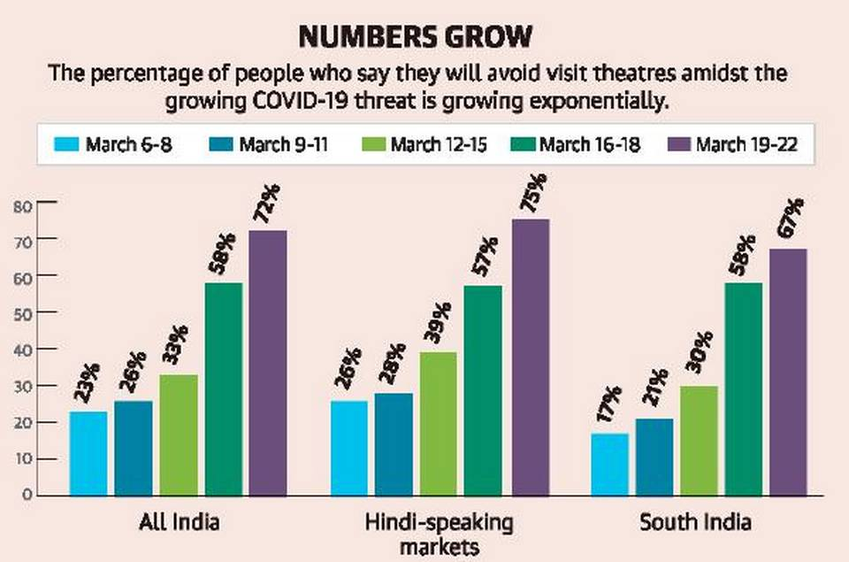
Entertainment
Big releases postponed, film, TV and web series shootings halted, theatres unable to screen movies, daily wage employees struggling for their next meal… the ₹183 billion Indian film industry is going through its worst phase because of the lockdown necessitated by the coronavirus pandemic.

Slide 11
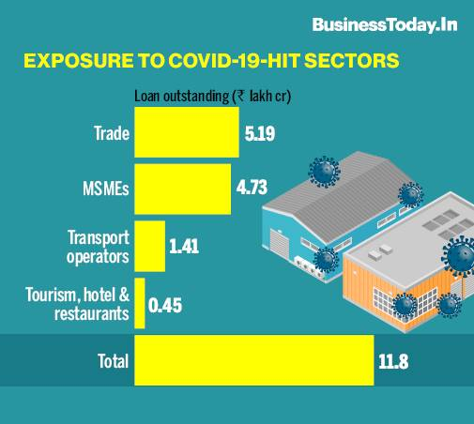
Banking
In India, the total exposure of banks to Covid-19 hit sectors is in excess of Rs 11 lakh crore. Especially for sectors such as hospitality, tourism, trade, transportation, aviation which have been impacted directly. Micro, small and medium enterprises (MSMEs) are also impacted because of shortage of funds and the size of their businesses.

Slide 12
Tourism/Hospitality
Both foreign tourist arrivals and domestic tourist movements are expected to remain very low.
On account of Coronavirus, the Indian tourism and hospitality industry is expecting a potential job loss of around 38 million.
In the third week of March 2020 itself, the hotel sector saw a decline of more than 65% in occupancy levels as compared to the same period in 2019.
Indian Association of Tour Operators (IATO) estimates the hotel, aviation and travel sector together may suffer a loss of about ₹85 billion keeping in mind the travel restrictions imposed on foreign tourists.
The passenger growth of airlines is likely to fall sharply to a negative 20-25% growth for the 2020-21.
Aviation industry in India could incur losses worth ₹ 27,000 crore ($3.3-3.6 billion) in the first quarter of 2020-21.

Slide 13
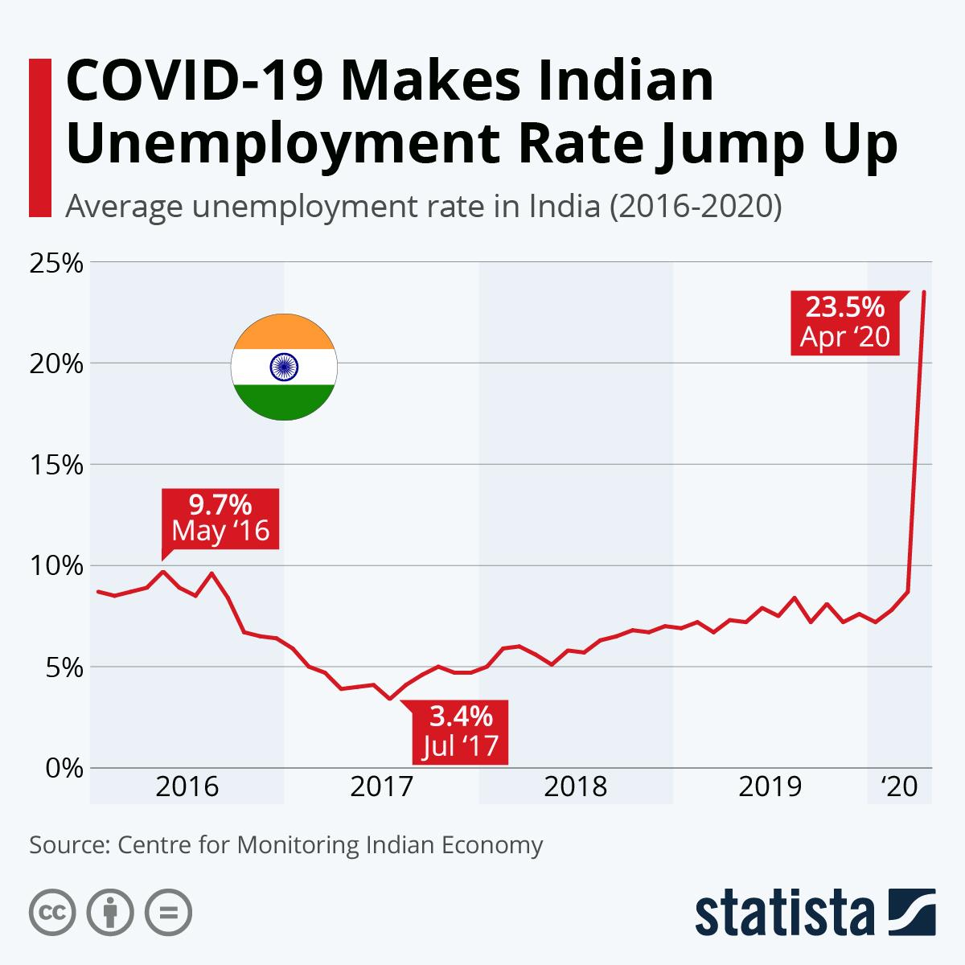
Impact on Employment
CMIE report says India’s urban unemployment rate soars to 30.9% even as overall rate rises to 23.4%, indicating covid-19’s impact on the economy.

Slide 14
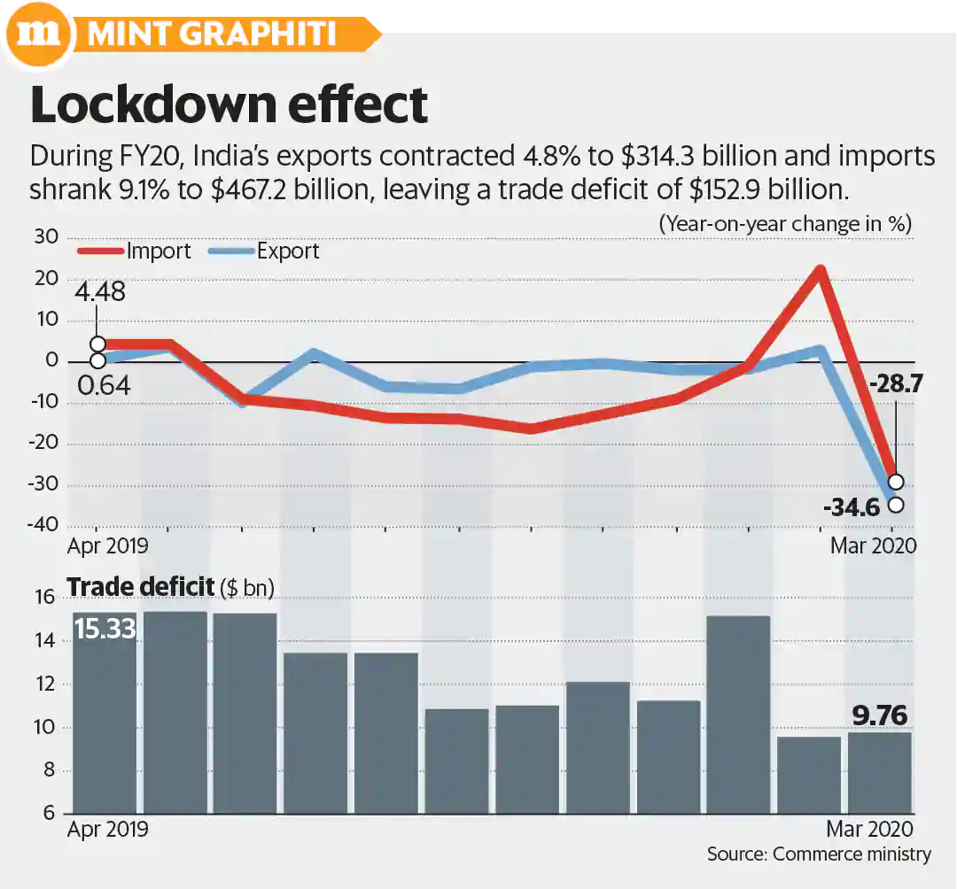
Impact on Import/Export
During FY20, contraction in India’s exports and imports left a trade deficit of $152.9 billion

Slide 15
Deeper look from state perspective
Top Eight states most affected by the COVID-19 pandemic account for over 60 per cent of the GDP and the extended restrictions will slam the economy harder.
The eight states, which include Maharashtra, Gujarat and Tamil Nadu, among others also account for 58 per cent of the employment, domestic rating agency Crisil’s research wing said in the report.
It noted that the top eight states have been selected as per the districts affected as of the end of the third lockdown on Sunday.
“At the all-India level, the virus spread and lockdowns, and restrictions have pummeled economic activity. While all states were near- uniformly hit during the first and second lockdown phases, the third and fourth would impact them differently,” it said.
Maharashtra, Tamil Nadu and Gujarat, being most dependent on output from industry and services, are more vulnerable to output losses as they face restrictions, it said.

Slide 16
Andhra Pradesh, Rajasthan and Uttar Pradesh are fiscally more vulnerable due to relatively higher debt ratios and also have high dependence on revenue sources from petroleum, liquor and stamp duty, it added.
Output could be more affected in the eight most pandemic-hit states as they face restrictions, it said, adding that the share of gross state value added (GSVA) from these states is 64 per cent in agriculture, 63 per cent in industry and 53 per cent in services.
Those with higher dependence on agriculture like Andhra Pradesh, Rajasthan, UP and West Bengal could fare better as a normal monsoon is expected to support it, it added.
Among the relatively less-hit states, restrictions on economic activity could hurt Karnataka and Kerala, where share of industry and services is higher, while in others like MP, Punjab and Bihar, a higher share of agriculture could cushion the economy this year.
Top 8 states by GSDP, namely-Maharashtra,Tamil Nadu,Gujarat,Karnataka,UP,West Bengal,Rajasthan,Andhra Pradesh.

Slide 17
How Indian Unicorns (start-ups with more than $1B valuation ) are performing amidst Covid-19?
1. OYO : Laying off 5000, most of them have been benched without pay.
2. Swiggy was observing but last week they have declared 1000 lay off is coming. They will reduce monthly burn from $40M to $5M
3. Snapdeal to lay off 80% of its workforce approx 1000
4. Flipkart- steady, no lay off, no pay cut.
5. InMobi - They have cut the salary and compensated employees by issuing more stock options
6. OLA -50% lay off
7. Quikr - Already laid off 80%
8. Paytm-laying off 500, since its parent Alibaba suffered loss
9. Byju's - Increased 200% growth in student registration , but not in revenue as they have made it free. But no news of lay off-they are doing better.
***
For most areas related to travel, food, entertainment- it is a complete wiped out.
Tech start-ups are standing with some hit.
Advertisement start-ups are hard hit.
But those who could align with Covid-19 emerging tech issues, like Byju’s are gaining fast ground.

Slide 18
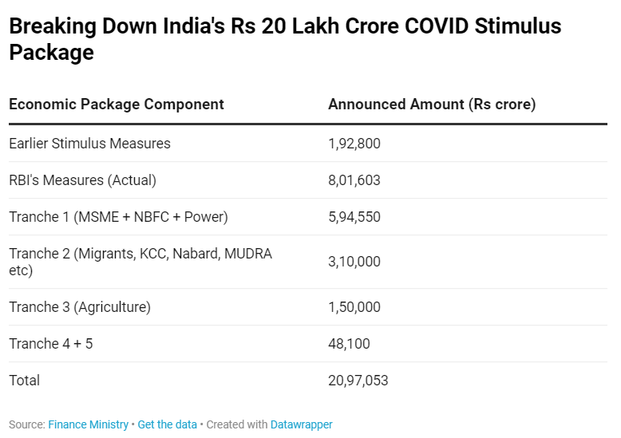
Steps taken by government
Prime Minister Narendra Modi had announced a relief package of ₹20 lakh crore or about 10 per cent or GDP. However, many of the measures unveiled have been in the form of moves like loan guarantees which do not entail an immediate fiscal cost.

Slide 19
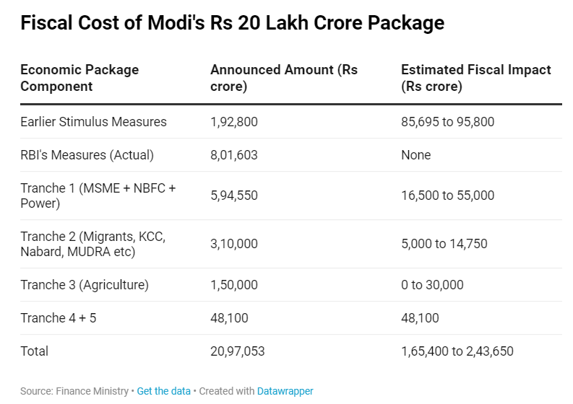

Slide 20
Possible steps by Govt. and Public
We are here compiling some possible solutions to the threat possessed by Covid-19:-
1. Direct cash transfer is the way out, not only for the poor, but also those hit by the long spell of lockdown , so as to enable people to spend . States like West Bengal has already done that . Nobel Laureate Abhijit Banerjee quotes ”People are not buying in these times and spending is the easiest way to revive the economy. We cannot shut the entire retail sector because they are situated in the coronavirus red zone,”
2. There is a need of cash stimulus package , which unfortunately seem to be missing in the GOI declared package . In such a situation, when there is no business and there are no demand for loans, the ₹20-lakh-crore stimulus package announced by the Centre in the wake of Covid-19 has only 0.05% cash component and the rest would all go through banking channels.
3. Government should aggressively go for the Data Science/AI/ sectors . As of now, the various Incubation Centers mostly(or prefer to) fund projects with some hardware presence , but, that needs to change. Startups like LUDO GAME , digital platforms like YOUTUBE are on boom , its time when we should give them as much importance as the traditional industries like the petrochemicals, manufacturing gets , and must learn that this is the new normal.
4. In a “Boycott China” trend , coupled with Covid-19 Pandemic actually opens an opportunity for app/web developers to grind their places.

Slide 21

This is the ultimate choice.
THANK YOU

